Slide 1
Random Forest Algorithm
Simple Guide to Classification & Regression
Ananda Rimal
Ananda Rimal
1/18

Slide 2
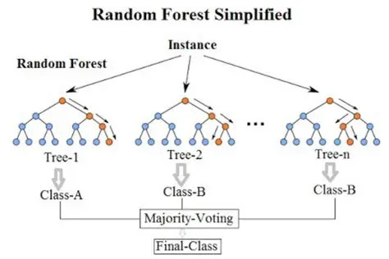

Slide 3


What is Random Forest?
Simple Definition
Random Forest = Many Decision Trees working together
Think of it like:
Asking 100 doctors instead of just 1 Each doctor gives their opinion Final answer = Majority vote wins!
1 Tree
Best Prediction!
Weak
Forest Strong!
Ananda Rimal
2/18

Slide 4
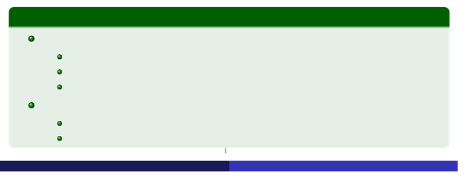
Why Use Random Forest?
Advantages:
High Accuracy: No Overfitting:
Better than single tree Many trees fix errors
Both Types:
Categories AND Numbers
Finds Important Features:
Knows what matters
Real Use:
Example
Category Prediction:
Email: Spam or Not Spam Disease: Sick or Healthy Customer: Will Buy or Won’t Buy
Number Prediction:
$
House price: 300,000
Temperature:25°C
Ananda Rimal
3/18

Slide 5

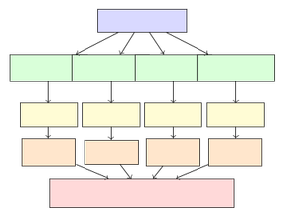
How Random Forest Works
1
Take Original Data
Create Random Samples Build Tree on Each Sample Each Tree Votes
Majority Wins!
2
3
4
5
Data
Sample 1Sample 2Sample 3Sample 4
Tree1 Spam
Tree2 Not
Tree3 Spam
Tree4 Spam
Result: SPAM (3 votes)
Ananda Rimal
4/18

Slide 6
Example 1: Will Customer Buy?
Dataset:
10 customers with their details
ID
1 2 3 4 5 6 7 8 9 10
Age
Young Young Middle Senior Senior Senior Middle Young Young Senior
Income
Low Low Low Medium High Medium High Medium High Medium
Student?
No
Yes
No
No
Yes
Yes
Yes
No
Yes
Yes
Buy?
No No Yes Yes Yes Yes Yes No Yes Yes
New Person:
Age=Young, Income=Medium, Student=No
Question:
Will this person buy? Yes or No?
Ananda Rimal
5/18

Slide 7

How Forest Decides - Customer Purchase
New Person:
Young, Medium Income, Not Student
5 Different Trees Give Their Opinion:
Tree
Tree1 Tree2 Tree3 Tree 4 Tree5
Looksat
Age,Income Age,Student Income,Student
Age, Income, Student Age,Income
Vote
No No No No Yes
Vote Count:
No=4,Yes=1
Final Decision
Majority says
NO
→
Will NOT buy!
Ananda Rimal
6/18

Slide 8
Example 2: Email Spam Detection
Dataset:
8 emails from inbox
ID
Has”FREE”
Yes
No
Yes
No
Yes
No
Yes
No
Has ”Win” Many Links
Spam?
Spam Not Spam Spam Not Spam Spam Not Spam Not Spam Spam
1 2 3 4 5 6 7 8
Yes No No No Yes No No Yes
Yes No Yes No No Yes No Yes
New Email:
Has ”FREE”, No ”Win”, Many Links
7 Trees Vote:
Spam, Spam, Spam, Not Spam, Spam, Spam, Not Spam
Result: SPAM (5 out of 7 votes)
Ananda Rimal
7/18

Slide 9

Example 3: Disease Diagnosis
Dataset:
Patient symptoms and diagnosis
ID
1 2 3 4 5 6 7 8
Fever
High None High Mild High None Mild None
Cough
Yes No Yes No
No Yes Yes No
Fatigue
Yes
No
No
No
Yes
No
Yes
No
Sick?
Yes No Yes No Yes No Yes No
New Patient:
Fever=High, Cough=No, Fatigue=Yes
Trees Vote:
Result
4 say Sick, 1 says Healthy
Yes, Yes, No, Yes, Yes
→
SICK
(Majority)
Ananda Rimal
8/18

Slide 10
Regression Example 1: House Price
Dataset:
House details and selling prices
Size(sqft)
1500
2000
1200
1800
2500
1400
Bedro oms
3
4
2
3
4
3
Age(yrs)
10
5
20
8
2
15
Lo cation
Urban Suburb Rural Urban Suburb Urban
Price
$ $ $ $ $ $
300K 450K 180K 350K 520K 280K
New House:
Size=1600, Beds=3, Age=12, Urban
Trees Predict Different Prices:
Tree1:$320K
Tree2:$340K
Tree3:
$295K
Tree 4: $350K
Tree 5: $315K
Average Price = $324,000
Ananda Rimal
9/18

Slide 11
Regression Example 2: Temperature Prediction
Dataset:
Weather conditions and temperature
Month
Jan Mar Jun Apr Jul Feb
Humidity
60%
45%
70%
50%
75%
55%
Cloud% Wind(km/h)
Temp(°C)
12
22
30
25
33
15
80 30 60 40 50 70
15 10 8 12 5 20
New Day:
Month=May, Humidity=55%, Cloud=45, Wind=10
Each Tree Predicts:
Tree 1: 26°C
Tree 2: 24°C
Tree 3: 27°C
Tree 4: 25°C
Tree 5: 23°C
Average = 25°C
Ananda Rimal
10 / 18

Slide 12
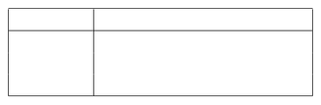
Key Idea 1: Bagging (Different Data)
Bootstrap = Random Sampling with Replacement
Take data randomly (some rows repeat, some left out) Each tree trains on slightly different data
Example:
Original 10 rows
Sample
Rows Selected
[1, 3, 3, 5, 7, 2, 9, 4, 8, 10] [2,4,6,8,1,3,7,9,5,5] [5,1,9,3,7,2,8,6,4,5]
Sample 1 Sample2 Sample3
Row 3 appears twice in Sample 1
Row 6 not in Sample 1 (used for testing!)
Ananda Rimal
11 / 18

Slide 13
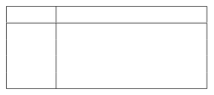

Key Idea 2: Random Features
Each tree looks at different features
Have many features (Age, Income, Student, etc.) Each split: randomly pick only few features
Tree chooses best among those few
Example:
Tree
Tree 1 Tree 2 Tree 3 Tree 4
Features Considered
Age, Income, Student Age, Credit, Job Income, Credit, Location Student, Job, Location
Why?
Different features = Trees think differently = Better together!
Ananda Rimal
12 / 18

Slide 14

Classification: Categories (Majority Vote)
Output:
Category (Spam/Not, Yes/No, Sick/Healthy)
Each tree votes for a category
→
Majority wins!
Examples:
Spam Detection:
7 trees
→ 5 say Spam, 2 say Not
→
Spam
Customer Buy:
5 trees
→ 4 say No, 1 says Yes
→
No
Disease:
9trees
→
7saySick,2sayHealthy
→
Sick
Simple Rule
Count votes for each category, pick the one with most votes!
Ananda Rimal
13 / 18

Slide 15

Regression: Numbers (Average)
Output:
Any number (Price, Temperature, Age)
Each tree predicts a number
→
Average them all!
Examples:
House Price:
Trees predict [320K, 340K, 295K, 350K, 315K]
$
Average = 324,000
Temperature:
°
Trees predict [26, 24, 27, 25, 23]
Average = 25 C
Simple Rule
Add all predictions, divide by number of trees!
Ananda Rimal
14 / 18

Slide 16

Complete Algorithm
Building the Forest (Training):
1
Start with your data
For each tree (build 100 trees):
2
Take random sample of data
At each split, randomly pick few features Choose best feature to split on
Grow tree completely
Making Predictions (New Data):
For Categories:
Each tree votes
→
Majority wins
For Numbers:
Each tree predicts
→
Take average
Ananda Rimal
15 / 18

Slide 17
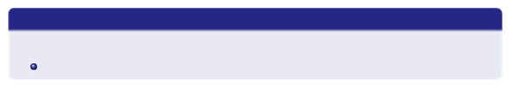
Real World Applications
Category Prediction:
Number Prediction:
Email:
Spam vs Not Spam
Real Estate:
House price
Medical: Banking:
Sick vs Healthy
Finance: Weather:
Stock price
Fraud vs Safe
Temperature
Shopping:
Buy vs Not Buy
Retail:
Sales forecast
Loan:
Approve vs Reject
Car: HR:
Fuel efficiency
Face ID:
Match vs No Match
Salary prediction
Bonus: Feature Importance
Forest also tells which features matter most!
House price: Size(40%), Location(30%), Bedrooms(20%), Age(10%)
Ananda Rimal
16 / 18

Slide 18

Summary
Random Forest in One Line
Many diverse trees working together = Better predictions
Rememb er:
Many Trees:
100 trees better than 1 tree
Bagging:
Each tree sees different data
Random Features:
Each tree thinks differently
Categories:
Count votes, majority wins
Numb ers:
Calculate average of all trees
Forest = Many Trees + Different Data + Different Feature
Ananda Rimal
17 / 18

Slide 19
ThankYou!
Prepared by: Ananda Rimal
Questions?
Ananda Rimal
18 / 18

